Slide 1
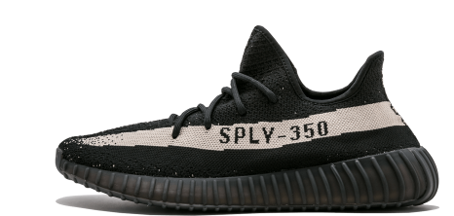
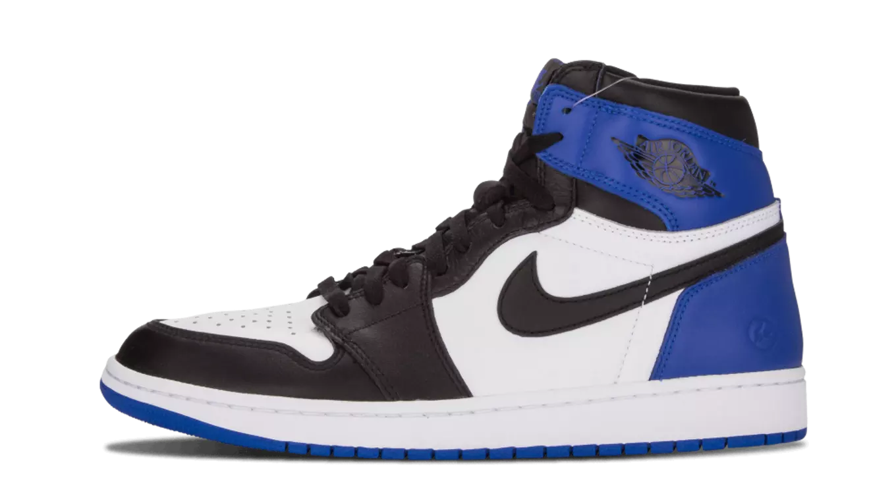
Shoe Resale Market Model
Arturas Malinauskas & David Martinez de la Cruz

Slide 2
Introduction

Slide 3
Background
Estimated 1 Billion USD of sneaker resale activity this year
Exclusive colors and models can be sold for over 1000% more than original retail price
Emergence in past 3 years of dedicated shoe resale sites: Stockx.com , Goat.com , Fightclub.com , and more
Interesting new market which has not been studied academically

Slide 4
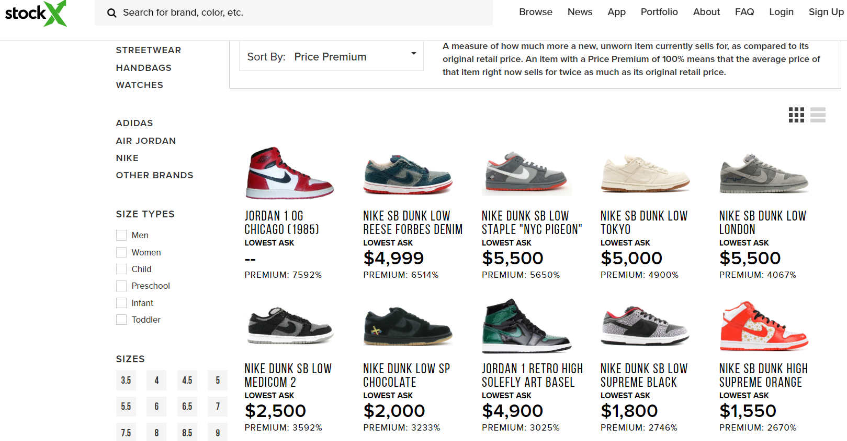
Image Source: https://stockx.com/sneakers/price-premium

Slide 5
Previous Literature
“Agent Based Simulation of a Financial market”
Agents are traders in a market
A fixed amount of capital and assets are traded
Prices are set based on supply and demand of the stocks
Random variables to differentiate agents desire to buy a stock
“Price Variations in a Stock Market with Many Agents”
Research on “bubbles” in prices
Two types of agents: “rational” and “noise” traders
Isolating market factors which impact price in uncertain ways

Slide 6
Challenges
Incorporating qualitative factors like style into the model
Creating distinct and useful representations of different types of players in the market
Avoiding arbitrary decisions to simplify the market model

Slide 7
Community Relevance
Understand if current growth in the market is sustainable
Identify ideal production level for sneaker manufacturers
Modeling this non-traditional market could be useful to identify important dynamics in other market types

Slide 8
Fundamental Questions
How does the proportion of sneakers to agents affect price?
How is price affected by the number of competing sneaker brands?
Which market parameters are the most impactful on price?
What behaviors of the sneaker market differ from a standard stock market model?

Slide 9
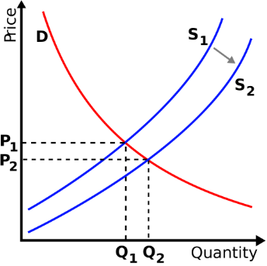
Initial Hypothesis I
How does the proportion of sneakers to agents affect price?
Higher Sneaker to Agent Ratio should reduce price and may decrease volatility
Image Source: https://www.toppr.com/guides/economics/market-equilibrium/shifts-in-demand-and-supply/

Slide 10
Initial Hypothesis II
How is price affected by the number of sneaker brands?
Prices decrease due to agent’s preferences for variety
Which market parameters are the most impactful on price?
Sneaker to Agent Ratio
What behaviors of the sneaker market differ from a standard stock market model?
Agents’ profit rates vary due to non-price preferences
Notes:
4:20 to go through intro

Slide 11
Methods & Implementation

Slide 12




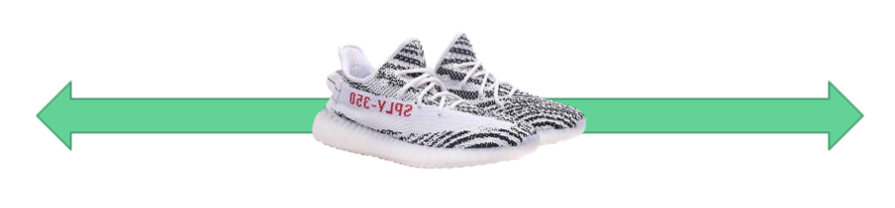
Simulation Methodology
AGENT BASED MODEL
TRENDSETTERS
PROFITEERS
SOCIALITES
COLLECTORS
SELLERS
BUYERS
Social status
Depending on agent’s sneakers and their social status
Selling price
Depending on demand and seller’s social status
Buying price
Depending on buyer’s desire and offer
How far they are from their objective
Depreciation
Vintageness

Slide 13
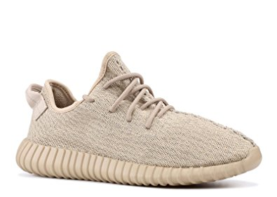
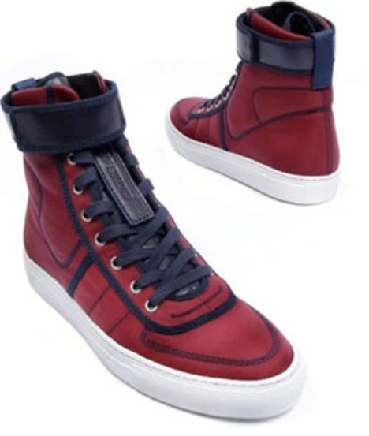
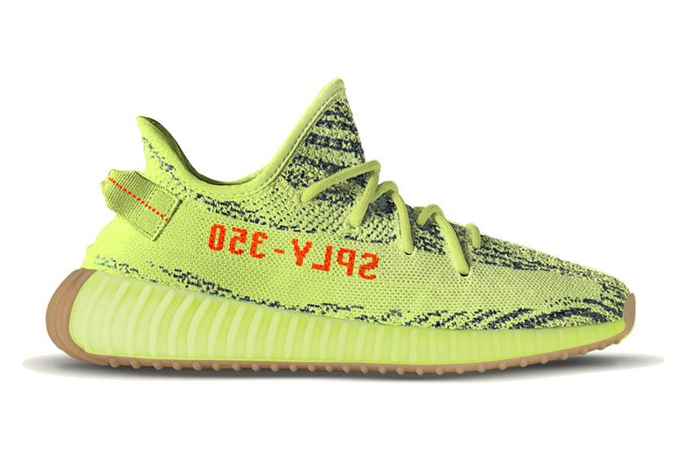


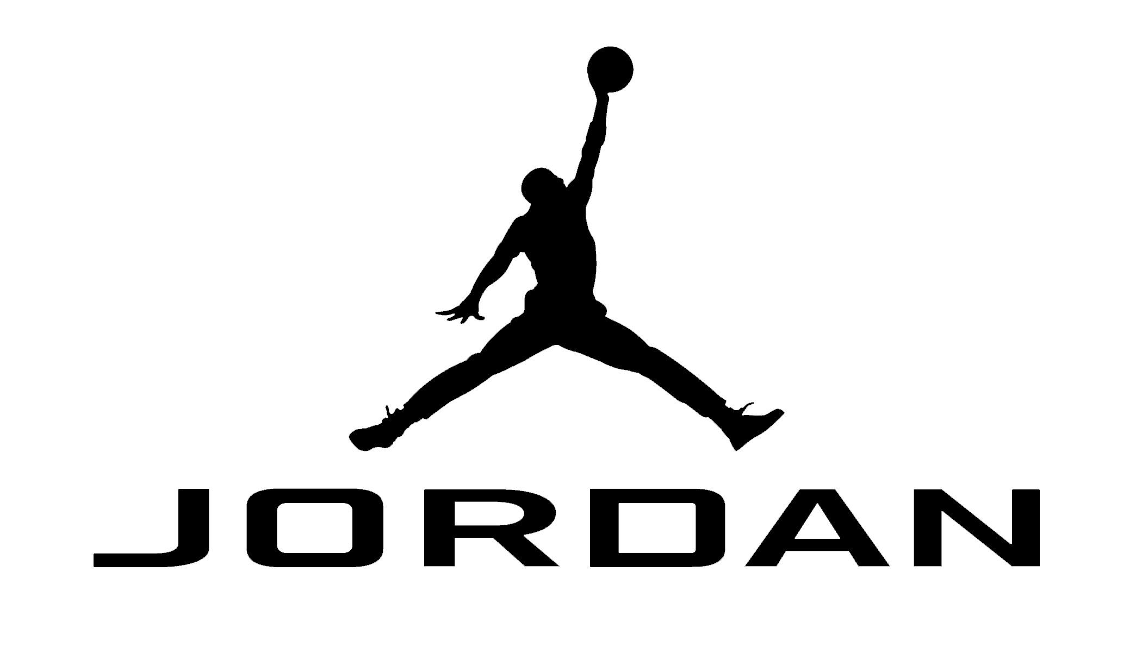
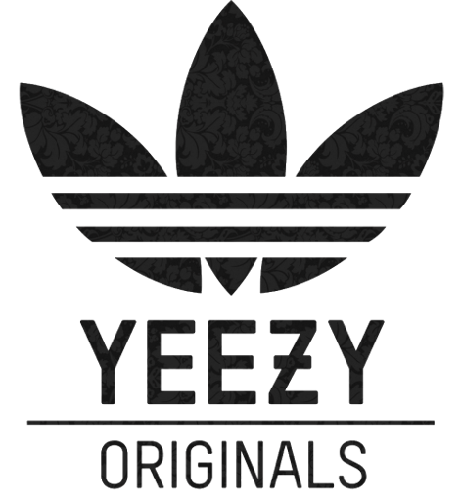

Simulation Parameters
NUMBER OF AGENTS
NUMBER OF SNEAKERS
INITIAL BUYING PRICE
Divided into the four types according to proportion
Distributed among the trendsetters. Given initial parameters based on brand
Estimated value for the buyer’s buying price. Determines the behavior in the beginning
NUMBER OF BRANDS
TIME STEPS
Duration of the simulation
1 time step = 1 day
Trendsetters are assigned randomly to one. Need to ensure a minimum number
Notes:
Inputs to the simulation

Slide 14
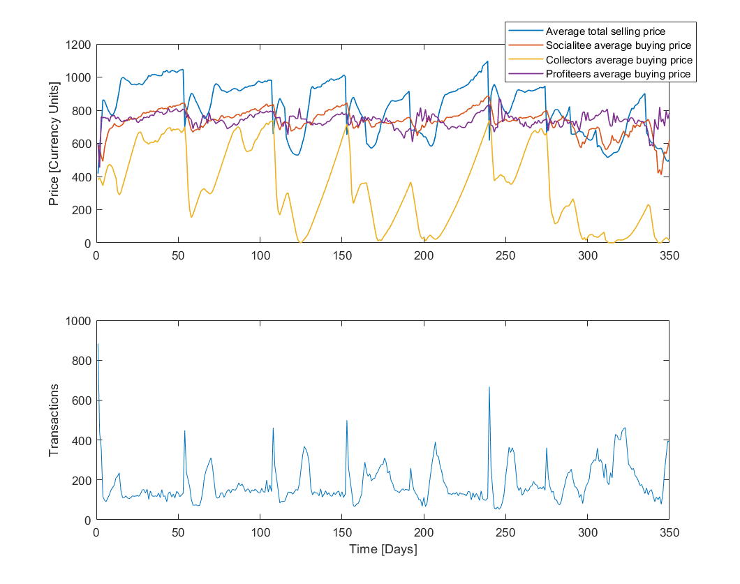
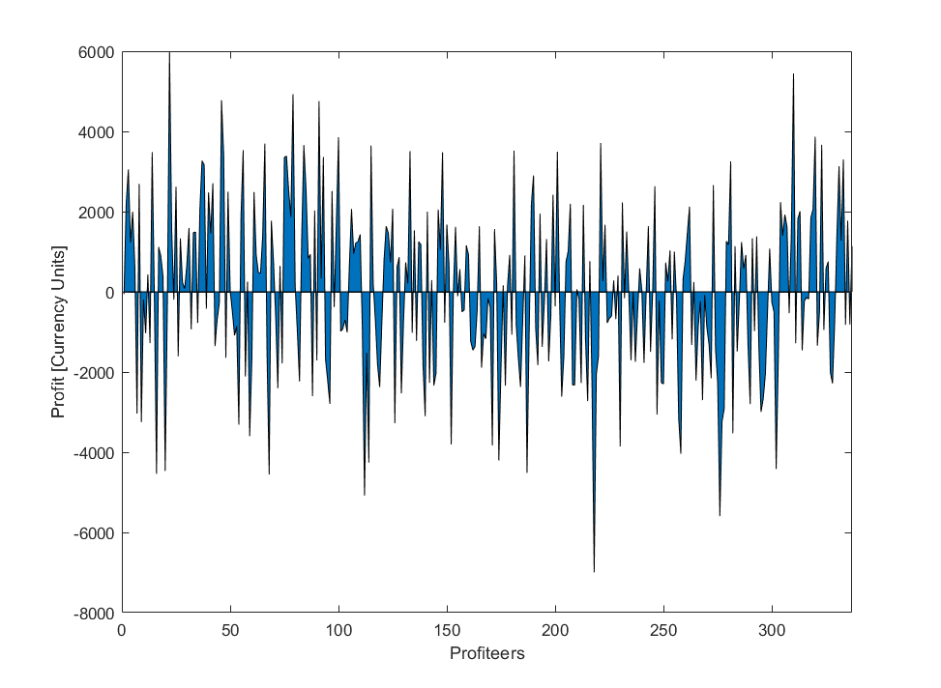
Nominal Simulation Case
1000 agents, 800 items, initial buying price of 700CU, 4 brands, 150 time steps
Average selling & buying price
Profit by profiteers
Transactions per day

Slide 15
Results

Slide 16
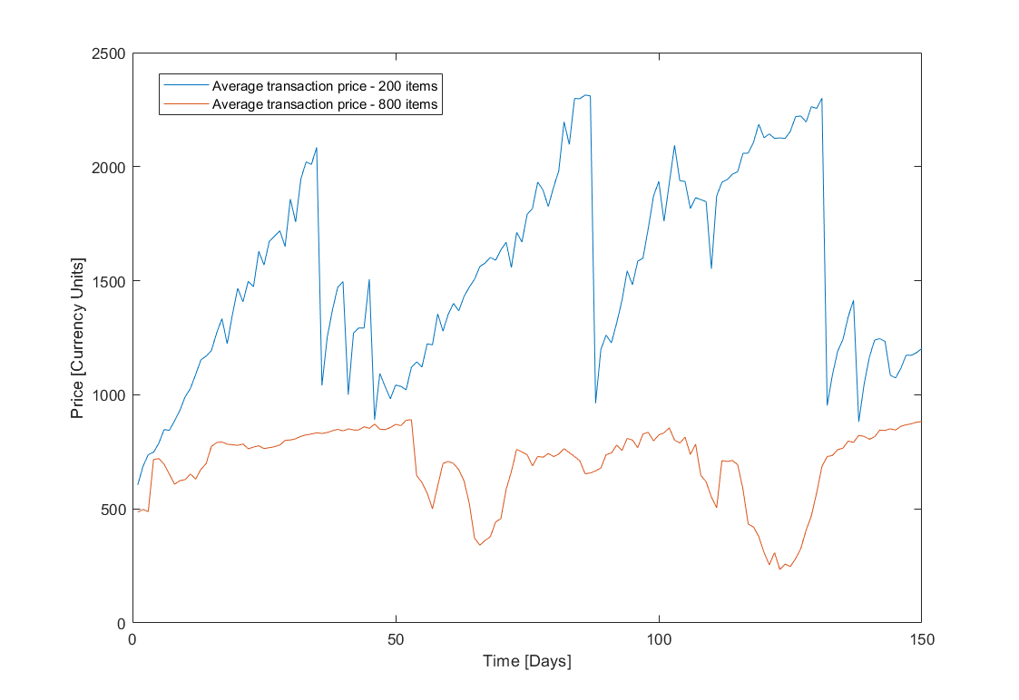
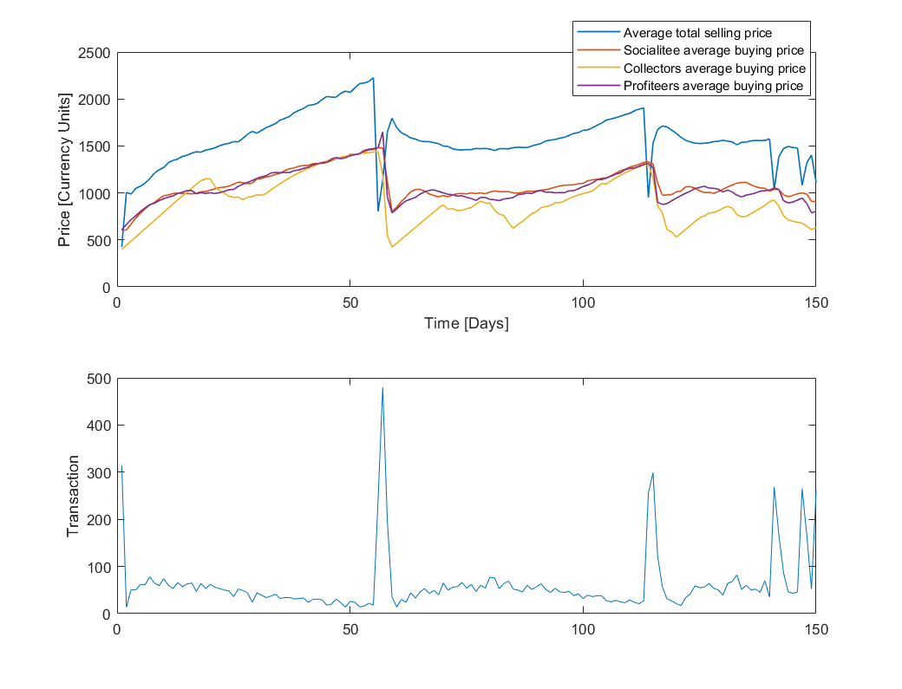
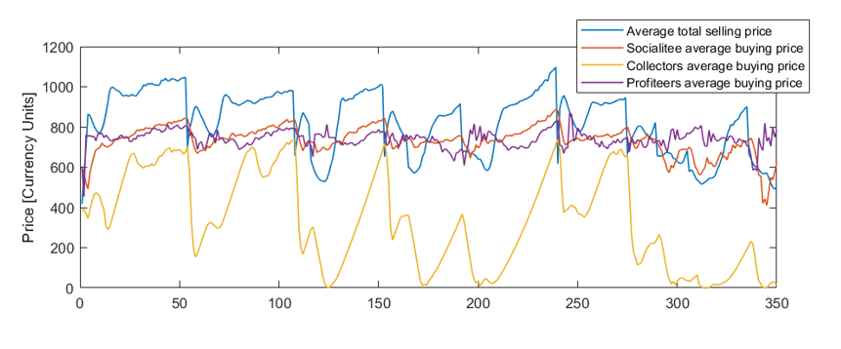
Varying the Ratio of Sneakers to Agents
1000 agents, 200 items, initial buying price of 700CU, 4 brands, 150 time steps
Average selling & buying price
Average transaction price
Nominal case
Results as expected! The average selling price increases

Slide 17
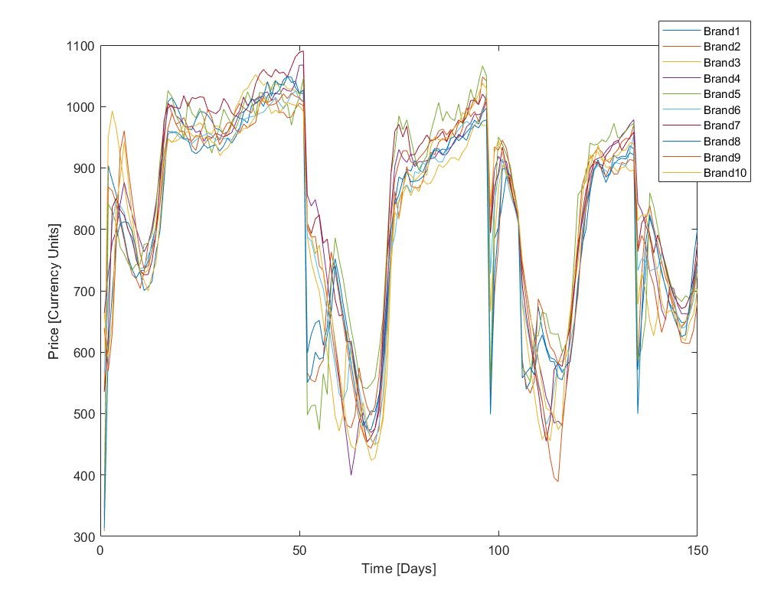
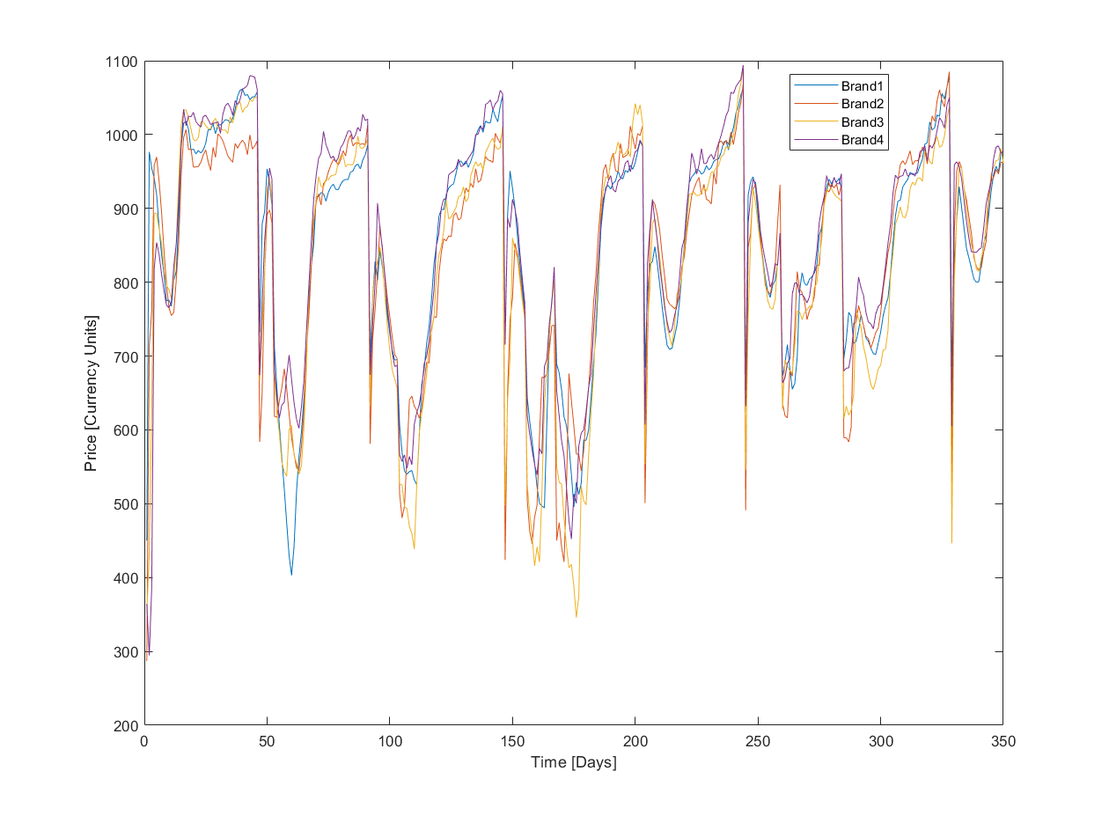
Varying the Number of Brands
1000 agents, 800 items, initial buying price of 700CU, 10 brands, 150 time steps
Average selling price per brand
Nominal case

Slide 18
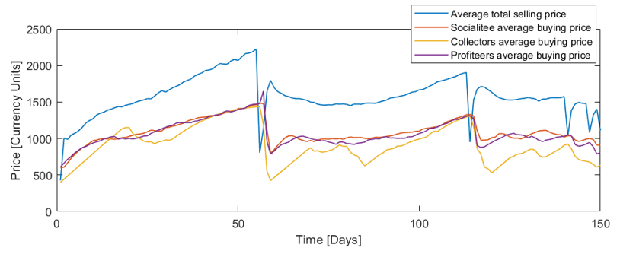

Most Influential Parameters
Low ratio sneakers/agents
High number of brands
Effect of low sneaker to agent ratio
>
Effect of high number of brands
Other parameters may be influential (i.e. decrease or increase in buying price)
Change in the intrinsic behavior of the market. Different nominal results

Slide 19

Shoe Market vs Stock Market
The Retail Shoe Market has associated an intangible value
The owner
VALUE
The time in the market
Vintageness and Depreciation
Notes:
8:05

Slide 20
Discussion

Slide 21
Limitations
Limited Number of Agents Simulated
Arbitrary parameters for style and fashion
Exclusion of counterfeit goods and scammers
Market has seasonal effects
Real people aren’t trading every day

Slide 22
Future Improvements
Optimize Code Data Structure
Source real world data from social media and marketplaces
Refine arbitrary parameters for greater meaning

Slide 23
Conclusions
Agent based model approximated behavior of the sneaker resale market

Slide 24
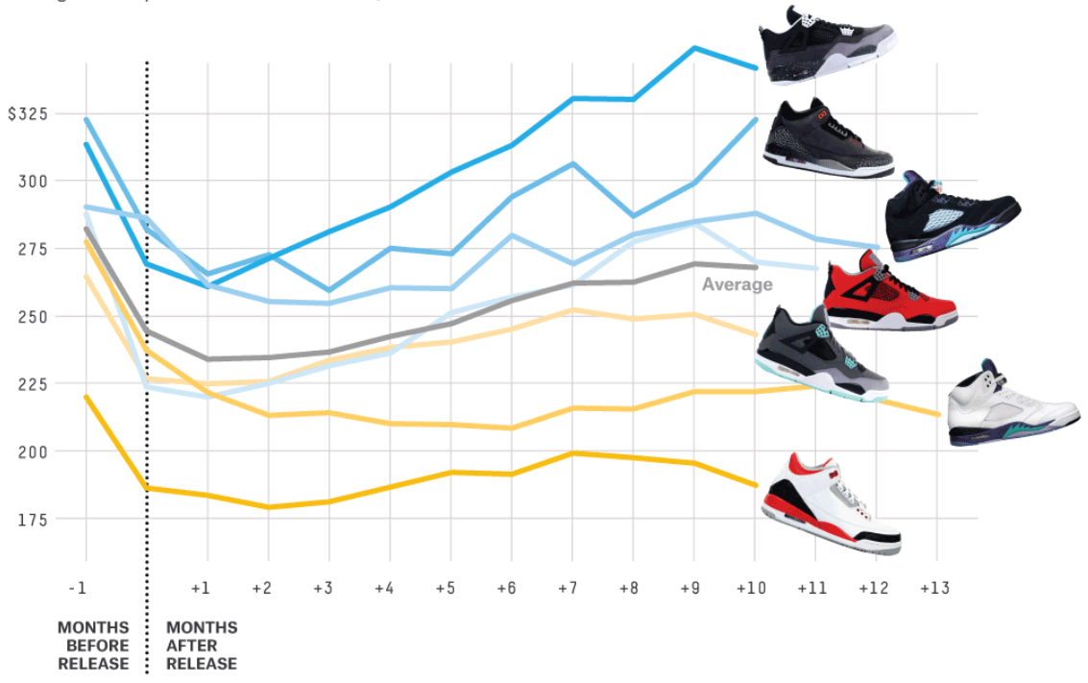
Image Source: https://fivethirtyeight.com/features/you-see-sneakers-these-guys-see-hundreds-of-millions-in-resale-profit/

Slide 25
Conclusions
Agent based model approximated behavior of the sneaker resale market
Identified scarcity of shoes as most important price factor

Slide 26
Conclusions
Agent based model approximated behavior of the sneaker resale market
Identified scarcity of shoes as most important price factor
Agents behavior is distinct based on their type

Slide 27
References
L. Chow. You See Sneakers, These Guys See Hundreds Of Millions In Resale Profit, October 2014. URL https://fivethirtyeight.com/features/you-see-sneakers -these-guys-see-hundreds-of-millions-in-resale-profit/
L. Steinberg. The Profitable Hidden Sneaker Market, September 2018. URL https://www.forbes.com/sites/leighsteinberg/2018/09/17/the-profitable-hidden-sneaker-market/#319df41c5925.
M. Raberto, S. Cincotti, S. M. Focardi, and M. Marchesi. Agent Based Simulation of a Financial market. Physica A Statistical Mechanics and its Applications, October 2001.
P. Bak, M. Paczuski, and M. Shubik. Price Variations in a Stock Market with Many Agents . Physica A Statistical Mechanics and its Applications, December 1997.

Slide 28

Questions .
Nike Logo Source: http://www.pngall.com/wp-content/uploads/2016/06/Nike-Logo-PNG.png
Notes:
2 min

